Slide 1
GOOD MORNING CLASS

Slide 2
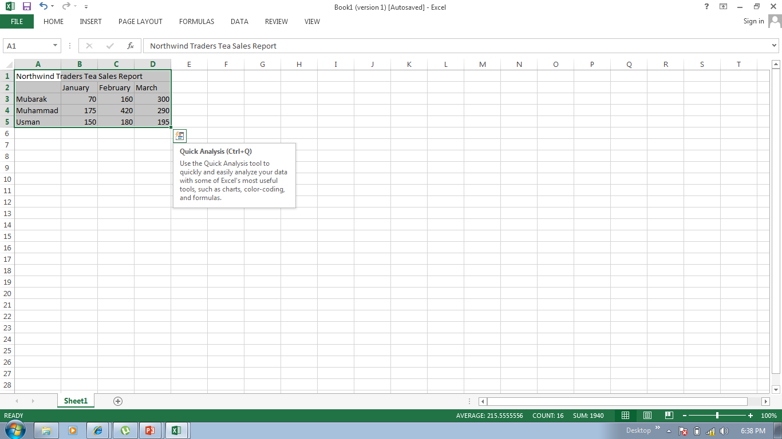
BASIC CHARTING TECHNIQUES
To create a new chart, start by selecting any cell within the data that you want to plot.
There are 4 steps to charts which are
Step 1. choosing the chart type
Step 2. specifying the data to plot
Step 3. choosing chart options
Step 4. deciding where to put the chart.

Slide 3
OVERVIEW CHARTS MAKE DATA VISUAL
A chart gets your point across – fast.
With chart, you can transform worksheet data to show comparisons, pattern, and trends.
So instead of having to analyze columns of worksheet numbers, you can see at a glance what the data means.
In this lecture, we will presents the basics of creating charts.

Slide 4
Here is a basic chart in excel, which you can put together in 10 seconds
After you create a chart, you can easily add new
elements to it such as chart titles or a new layout

Slide 5
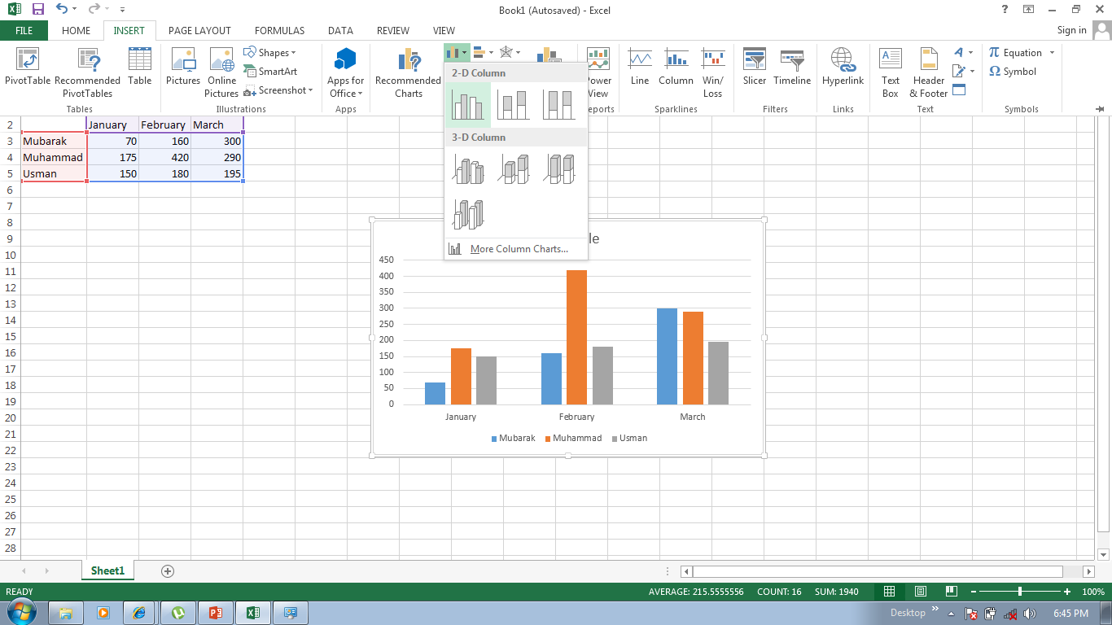
Here is a worksheet that shows how many cases of north wind traders tea were sold by each of the three sales people in three months.
You want to create a chart that shows each
salesperson compares against the others, month by
month, for the first quarter of the year.

Slide 6
The picture shows the steps for creating the chart.
Select the data that you want to chart, including the
column titles (January, February, March) and the row
Labels (the salesperson names)
Click the insert tab, and in the charts group, click
the column button.

Slide 7
The picture shows the steps for creating the chart.
3. You will see a number of column chart types to choose
From. Click clustered column, the first column chart in
the 2-D column list.
that’s it. You have created a chart in about 10 seconds

Slide 8
If you want to change the chart type after creating your chart, click inside the chart.
On the design tab under chart tools, in the type
Group, click change chart type. Then select the chart
type you want.

Slide 9
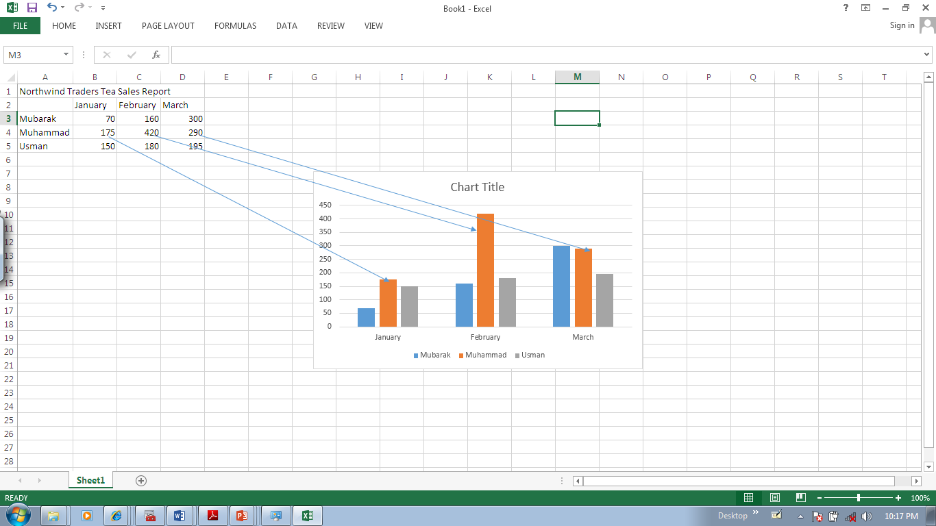
Here is how your new column chart looks.
It shows you at once that Muhammad (represented by the
Middle column for each month) sold the most tea in
January and February but was outdone by Mubarak in
March.

Slide 10
Data for each salesperson appears in three separate columns, one for each month.
The height of each chart is proportional to the value in
The cell that it represents.
So the chart immediately shows you how the
Salespeople stack up against each other, month by
month

Slide 11
Each row of salesperson data has a different color in the chart..
The chart legend, created from the row titles in the
worksheet (the salesperson names), tells which color
represents the data for each salesperson
Mubarak data, for example, is the blue, and is
the left-most column for each month.

Slide 12
The column titles from the worksheet- January, February, and March – are now at the button of the chart.
On the left side of the chart, excel has created a scale of
Numbers to help you to interpret the column heights.

Slide 13
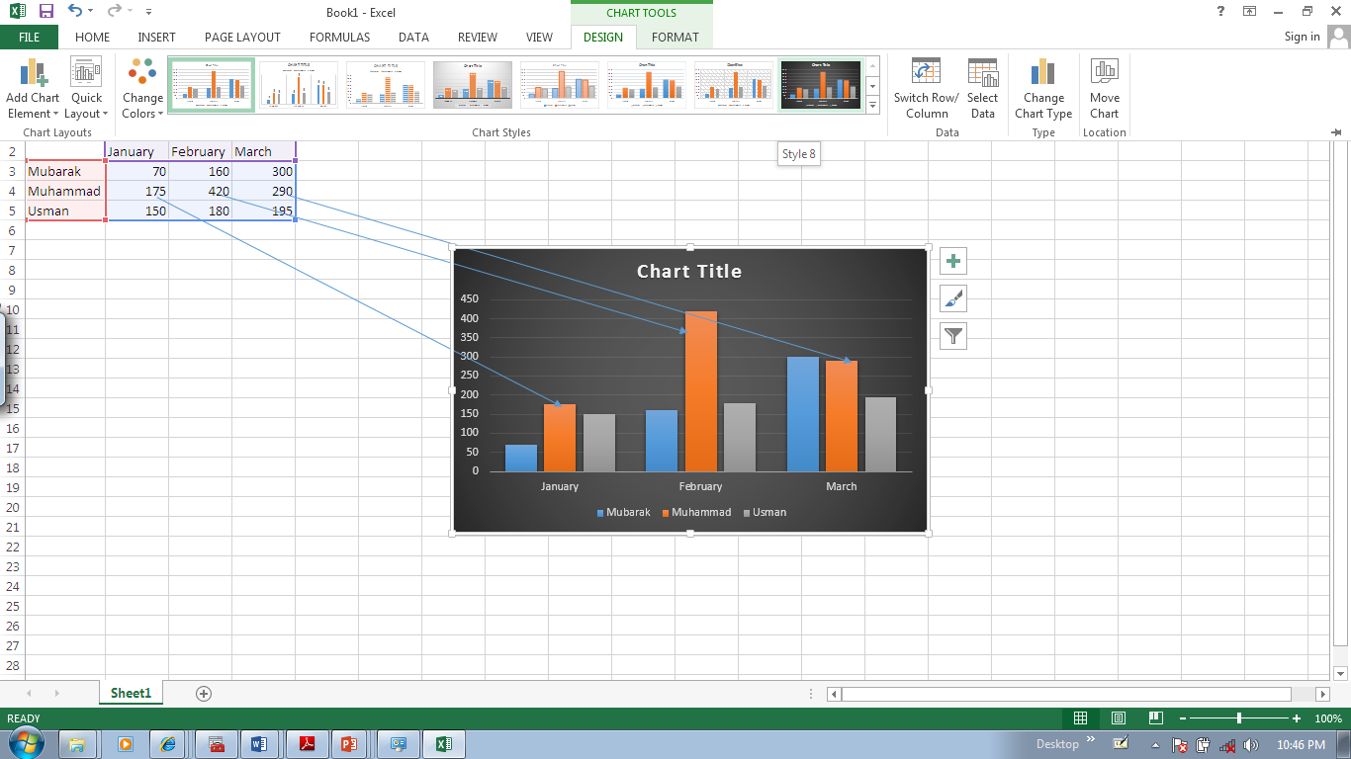
Before you do more work with your chart, you need to know about the chart tools
Charts Tools : Now You See Them, Now You Don’t
After your chart is inserted on the worksheet, the chart
tools appear on the ribbon with three tabs: design,
Layout, and format.
On these tabs, you will find the commands you need to
Work with charts.

Slide 14
When you complete the chart, click outside it. The chart tools go away. To get them back, click inside the chart, then the tabs reappear
Charts Tools : Now You See Them, Now You Don’t
So don’t worry if you don’t see all the commands you
need at all times.
Take the first steps either by inserting a chart (using the
Charts groups on the insert tab), or by clicking inside an
existing chart. The commands you need will be at hand.

Slide 15
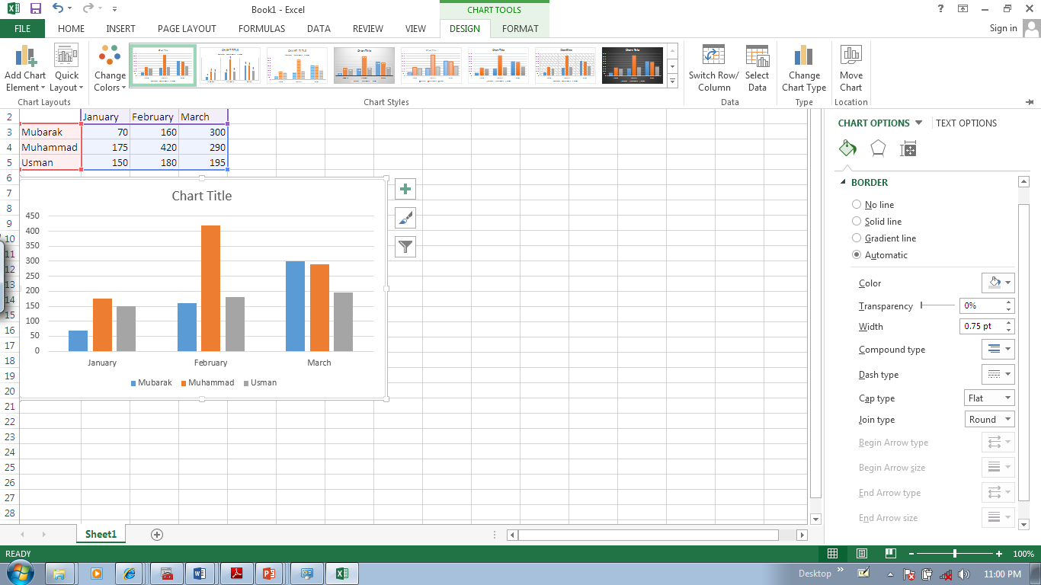
You can do more with your data than create one chart.
Change the chart view
You can make your chart compare data another way by
Clicking a button to switch from one chart view to
Another
The picture shows two different view of the same
Worksheet data.

Slide 16
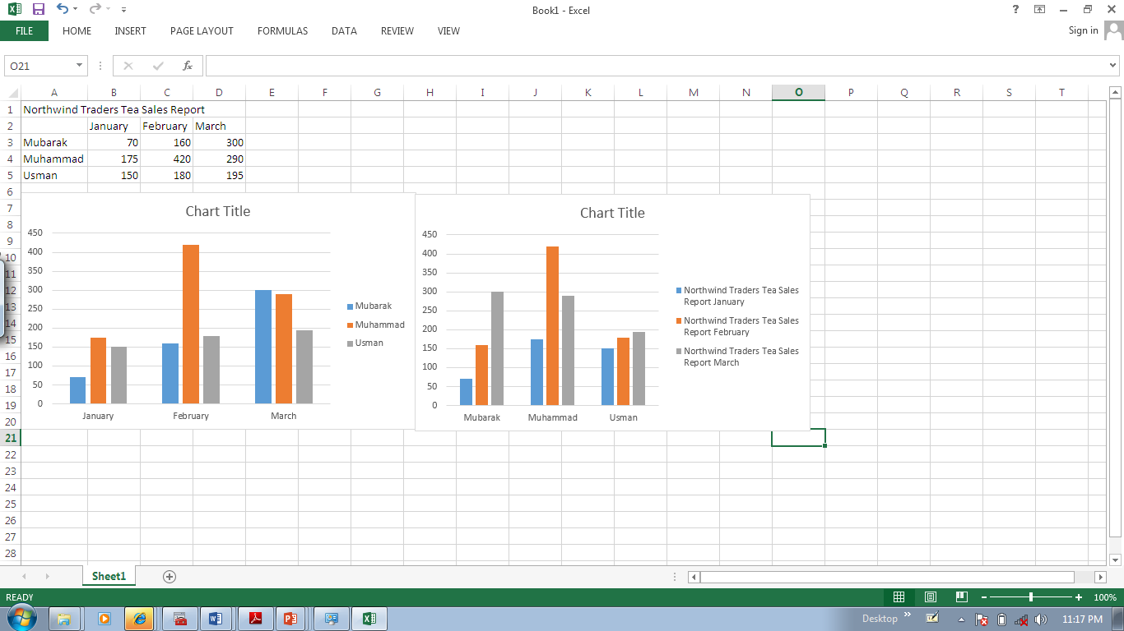
The chart on the left is the chart you first created, which compares salespeople to each other.
Change the chart view
Excel grouped data by worksheet columns and
Compared worksheet rows to show how each
Salesperson compares against the others

Slide 17
But another way to look at the data is to compare sales for each salesperson, month over month.
Change the chart view
To create this view of the chart, click switch
Row/column in the data group on the design tab.
In the chart on the right, data is grouped by rows and compares worksheet columns. So now your chart says something different: it shows how each salesperson did, month by month, compared against themselves.

Slide 18
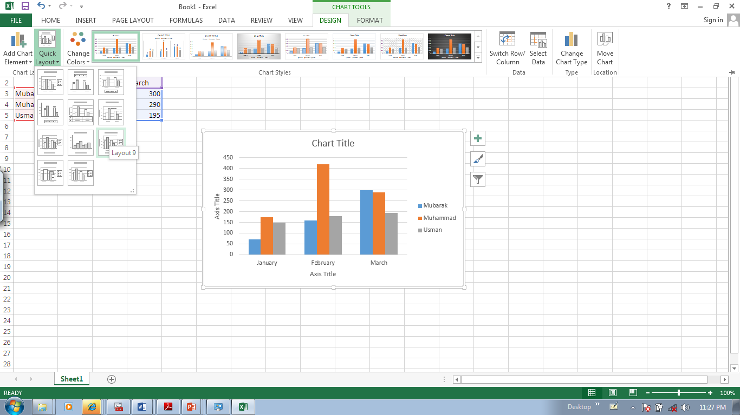
It’s a good idea to add descriptive titles to your chart, so that readers don’t have to guess what the chart is about
Add chart titles
You can give a title to the chart itself, as well as to the chart axes, which measure and describe the chart data.
This chart has two axes. On the left side is the vertical axis, which is the scale of numbers by which you can interpret the column heights. The months of the year at the bottom are on the horizontal axis

Slide 19
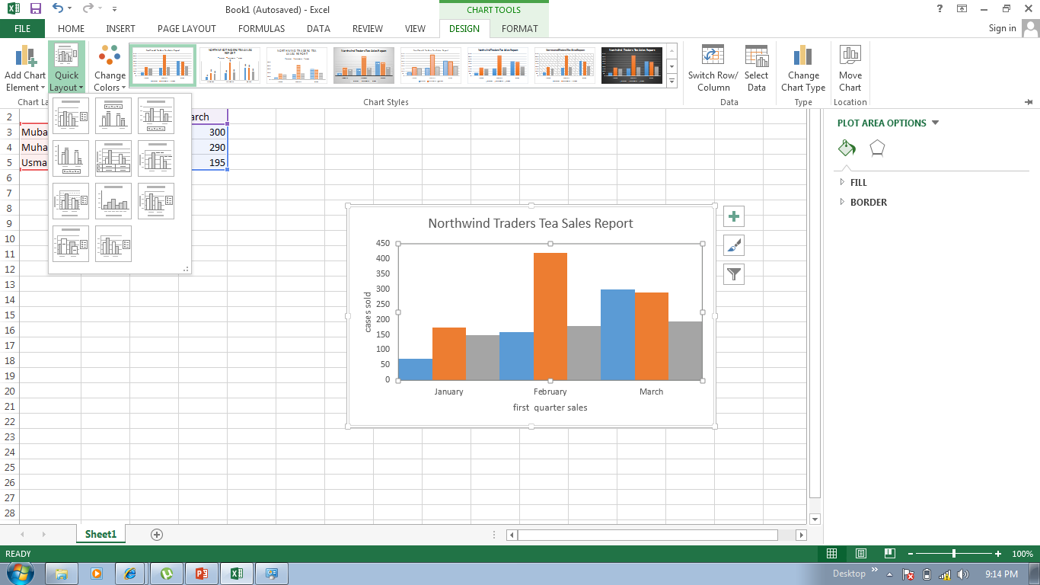
A quick way to add chart titles is to click the chart to select it, and then go to the Charts layout group on the Design tab.
Add chart titles
Click the More button to see all the layouts. Each option shows different layouts that change the way chart elements are laid out.

Slide 20
The picture shows layout, which adds placeholders for a chart title and axes titles. You type the titles directly in the chart
Add chart titles
The title for the chart is North wind Traders Tea, the name of the product.
The title for the vertical axis on the left is Cases Sold.
The title for the horizontal axis at the bottom is First Quarter Sales.

Slide 21
Questions
You have created a chart, you want to compare data in another way. To do this, you must create a second chart.
True or false
You create a chart, but later on you don’t see the chart tool. What do you do to get them back?
Create another chart
Click the Insert tab
Click inside the chart.

Slide 22
Answers
False
You can create another view of your data by clicking the Switch Row/Column button on the Design tab
Click inside the chart.
The Chart tools will then be at hand with three tabs: Design, Layout, and Format.

Slide 23
5 minutes break

Slide 24
After you created your chart, you can customize it to give it a more professional design
Customize your chart
For example, you can give your chart a different colors by selecting a new chart style.
You can also format chart titles, to change them from plain to fancy, there are also many more formatting options that can be applied to individual columns to make them stand out.

Slide 25
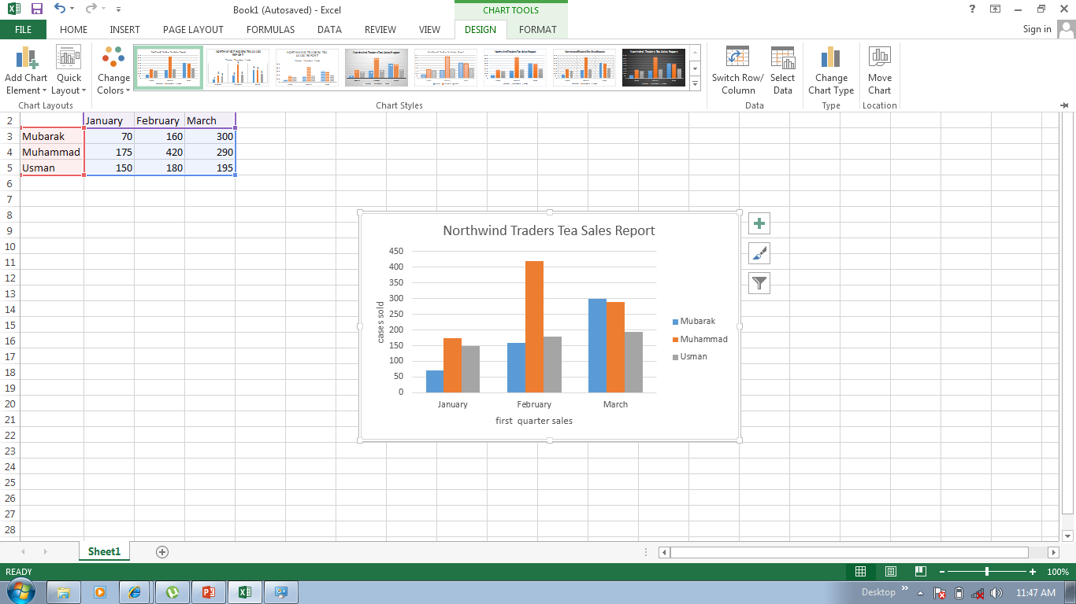
When you first create your chart, it is in a standard color. By using a Chart style, you can apply different colors to a chart in just second
Change the look of your chart
Some of the styles change just the color of the columns.
Others change the color and add an outline around the columns, while other styles add color to the area (area bounded by the chart axes). And some styles add color to the chart area (the entire chart)

Slide 26
If you don’t see what you want in the Chart Styles group, you can get other color choices by selecting a different Theme.
Change the look of your chart
Click the Page Layout tab, and then click Colors in the Themes group.
When you rest the pointer over the color scheme, the colors are shown in a temporary preview on the chart. Click the one you like to apply it to the chart.

Slide 27
Important. Unlike a chart style, the colors from a theme will be applied to other elements you might add to the worksheet
Change the look of your chart
For example, a table or a cell style such as a heading will take on the colors of the theme applied to the chart

Slide 28
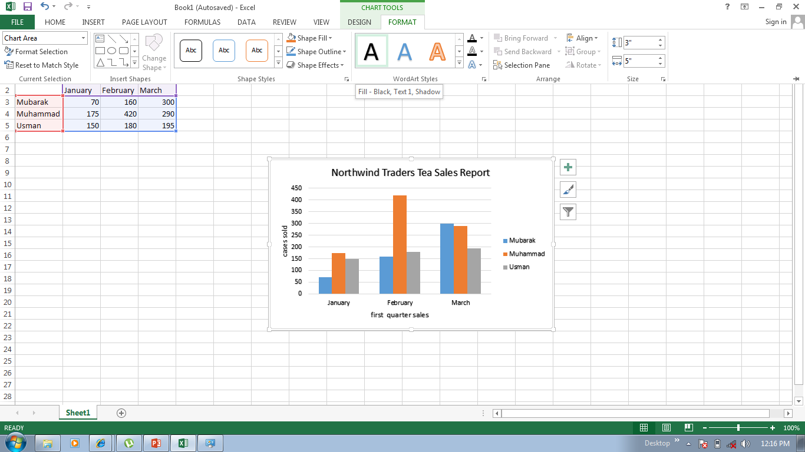
If you’d like to make the chart or axis titles stand out more, that is also easy to do
Format titles
On the Format tab, in the WordArt Styles group, there are many ways to work with the titles.
The picture shows that one of the options in the group, a text fill, has been added to change the color

Slide 29
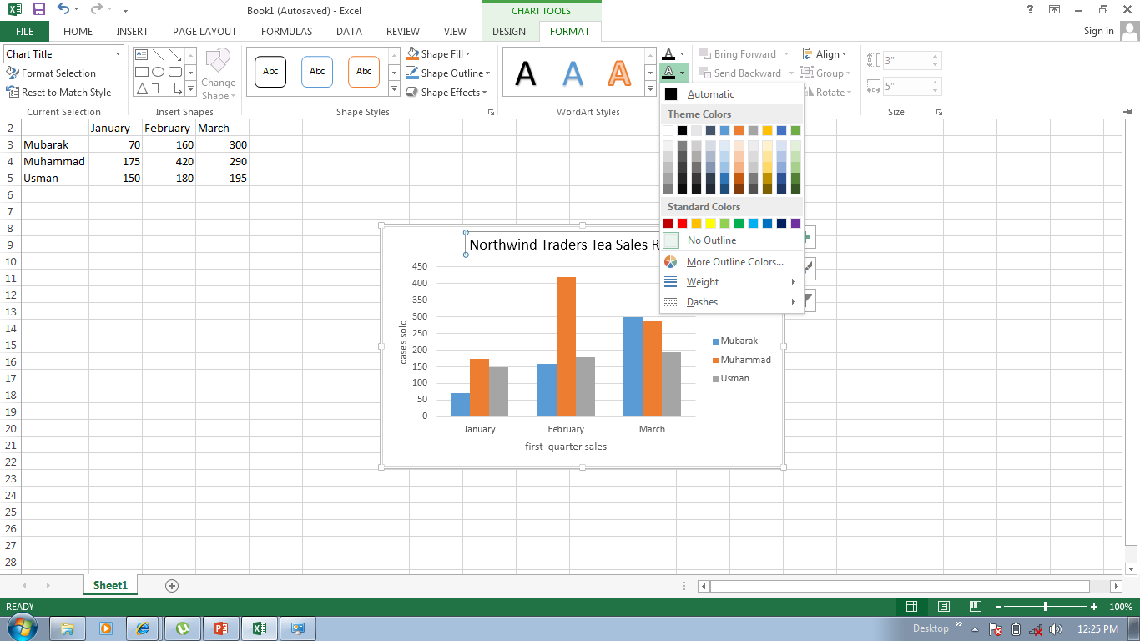
To use text fill, first click in the title to select it
Format titles
Then click the arrow on the Text Fill in the WordArt Styles group. Rest the pointer over any of the colors to see the changes in the title. When you see a color you like, select it.
Text Fill also includes options to apply a gradient or a texture to a title

Slide 30
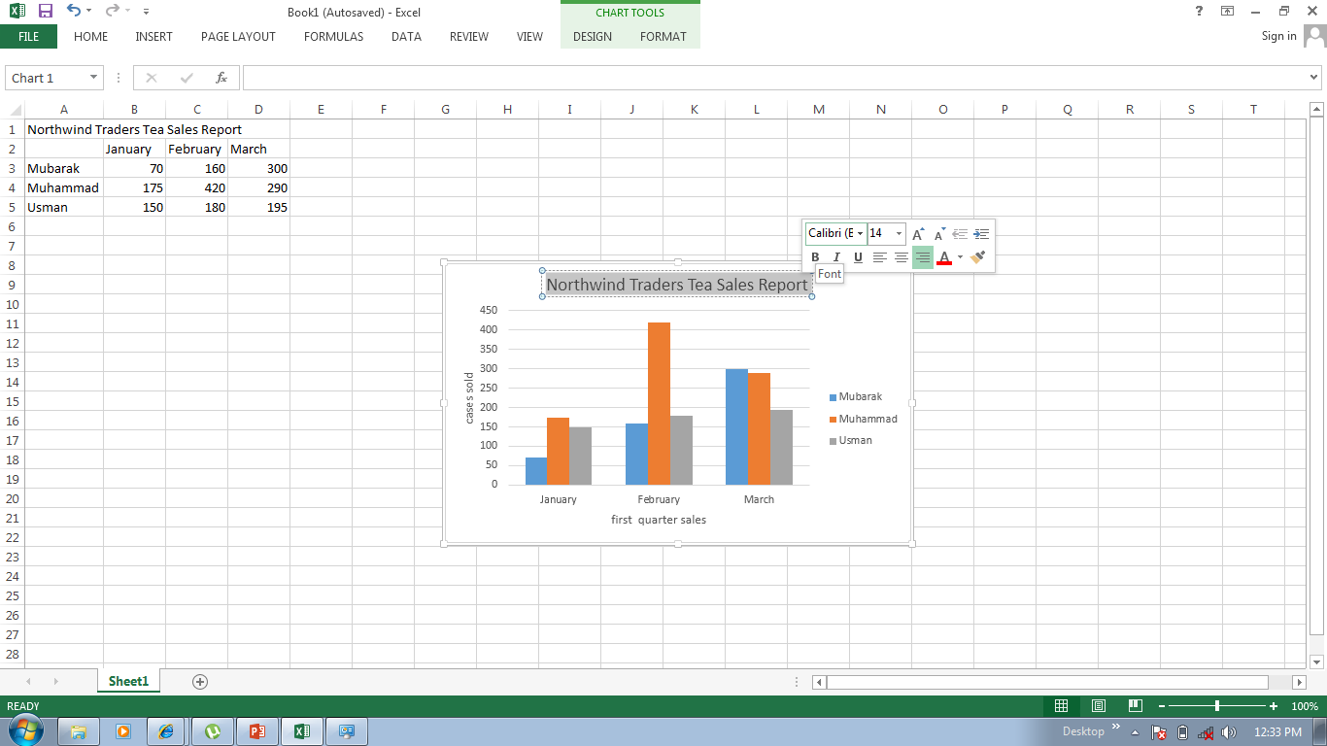
To make font changes, such as making the font larger or smaller, or to change the font face- click Home, and then go to the Font group
Format titles
Or you can make the same formatting changes by using the Mini Toolbar.
The toolbar appears in a faded fashion after you select the title text. Point at the toolbar and it becomes solid, and then you select a formatting option

Slide 31
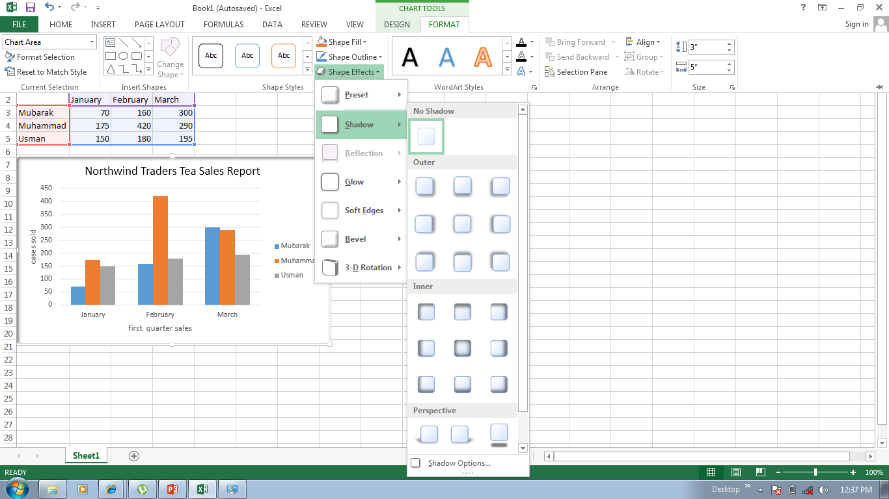
There is still more that you can do with the format of the columns
Format individual columns
In the picture, a shadow effect has been added to each of the columns (an offset diagonal shadow is behind each column).

Slide 32
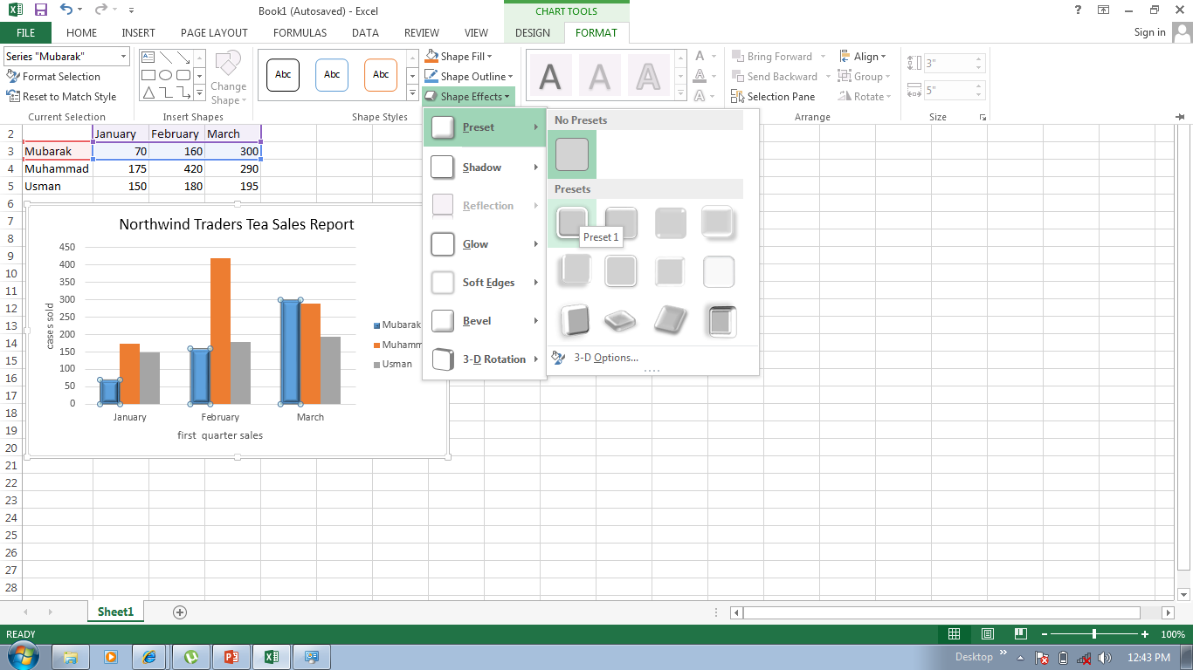
Here is how to add a shadow effect to column
Format individual columns
Click one of Mubarak’s column. That will select all three columns for Mubarak (known as series).
On the Format tab, in the Shape Styles group, click the arrow on Shape Effects

Slide 33
Here is how to add a shadow effect to column
Format individual columns
Point to shadow, and then rest the pointer on the different shadow styles in the list.
You can see a preview of the shadows as you rest the pointer on each style. When you see one you like, select it.

Slide 34
The Shape Styles group offers plenty of other great formatting options to choose from.
Format individual columns
Apart from Shape Effects, you can also click Shape Fill to add a gradient or a texture to the columns, or click Shape Outline to add an outline around the columns

Slide 35
You can add your chart to a Microsoft power point presentation
Add your chart to power point presentation
Copy the chart in excel
Open power point
Paste the chart on the slide you want it to appear

Slide 36
Questions
If you don’t see all the colors you want in the chart style group, you have another way to get more colors
True or false
2. What do you do to add an excel chart to a PowerPoint presentation ?
Click the data tab
Click the insert tab
Copy the chart

Slide 37
Answers
True
You can pick other colors by selecting a theme.
2. Copy the chart.
Then open PowerPoint, paste, and it is done

Slide 38
THANKS FOR YOUR TIME

